Slide 1
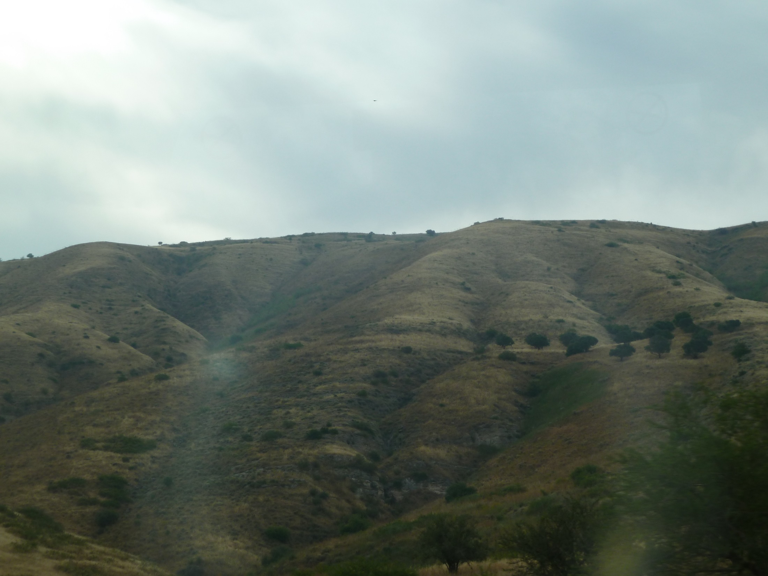
John 6.1-21
View of the Golan Heights
from the east side of the Sea of Galilee

Slide 2
¹After this Jesus went away to the other side of the Sea of Galilee (also called the Sea of Tiberias). ²A large crowd was following him because they were observing the miraculous signs he was performing on the sick. ³So Jesus went on up the mountainside and sat down there with his disciples.

Slide 3
¹After this Jesus went away to the other side of the Sea of Galilee (also called the Sea of Tiberias).
²A large crowd was following him because they were observing the miraculous signs he was performing on the sick.
Bethsaida

Slide 4
²A large crowd was following him because they were observing the miraculous signs he was performing on the sick. ³So Jesus went on up the mountainside and sat down there with his disciples.
Bethsaida
Crowd Gathering

Slide 5
⁴(Now the Jewish feast of the Passover was near.) ⁵Then Jesus, when he looked up and saw that a large crowd was coming to him, said to Philip, “Where can we buy bread so that these people may eat?” ⁶(Now Jesus said this to test him, for he knew what he was going to do.) ⁷Philip replied, “Two hundred silver coins worth of bread would not be enough for them, for each one to get a little.” ⁸One of Jesus' disciples, Andrew, Simon Peter's brother, said to him, ⁹“Here is a boy who has five barley loaves and two fish, but what good are these for so many people?”

Slide 6
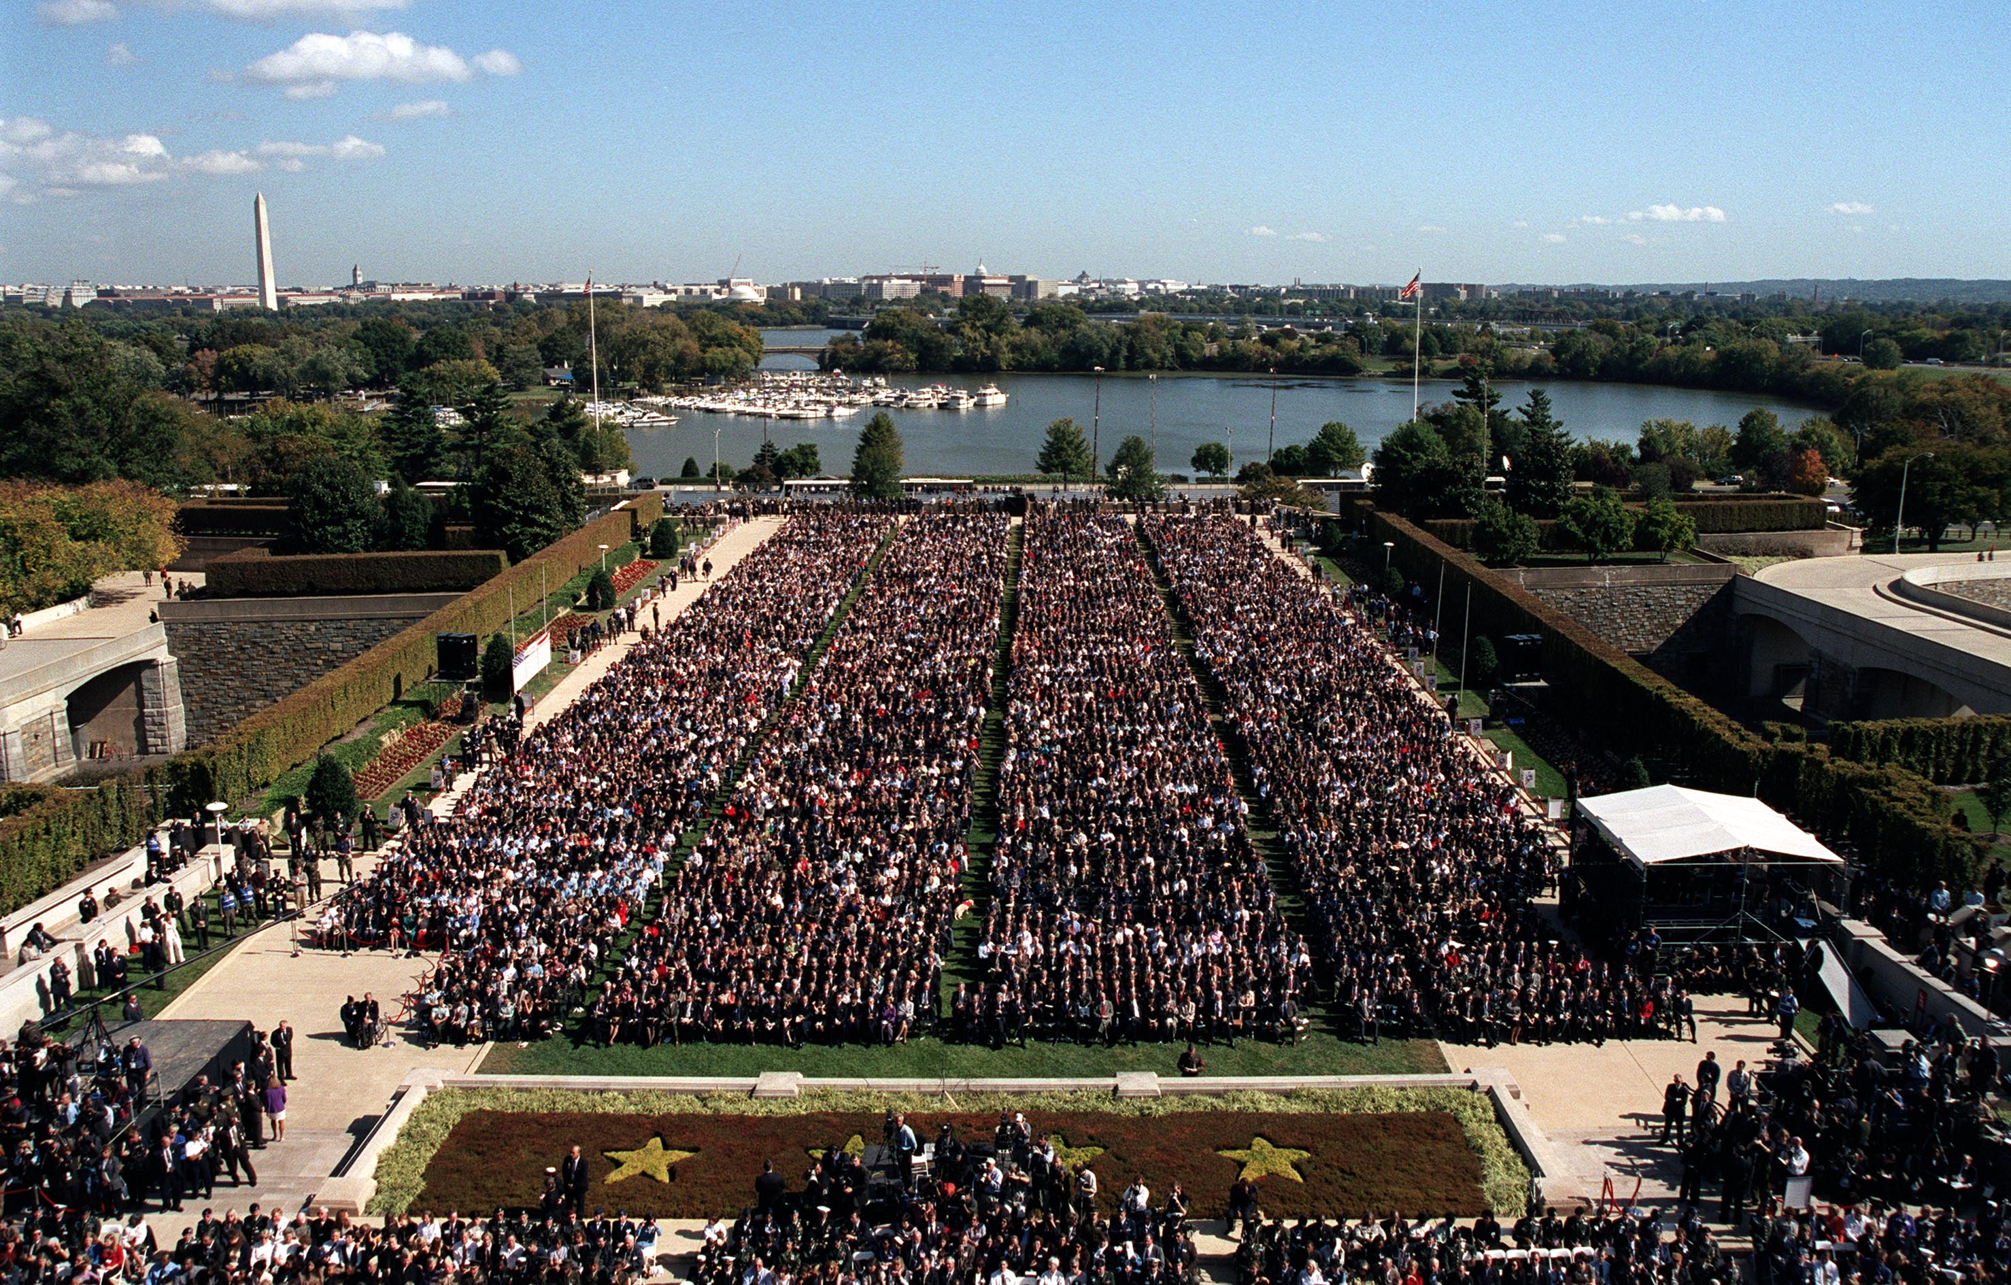
⁵Then Jesus, when he looked up and saw that a large crowd was coming to him, said to Philip, “Where can we buy bread so that these people may eat?”

Slide 7
⁶(Now Jesus said this to test him, for he knew what he was going to do.) ⁷Philip replied, “Two hundred silver coins worth of bread would not be enough for them, for each one to get a little.” ⁸One of Jesus' disciples, Andrew, Simon Peter's brother, said to him, ⁹“Here is a boy who has five barley loaves and two fish, but what good are these for so many people?”

Slide 8
¹⁰Jesus said, “Have the people sit down.” (Now there was a lot of grass in that place.) So the men sat down, about five thousand in number. ¹¹Then Jesus took the loaves, and when he had given thanks, he distributed the bread to those who were seated. He then did the same with the fish, as much as they wanted. ¹²When they were all satisfied, Jesus said to his disciples, “Gather up the broken pieces that are left over, so that nothing is wasted.” ¹³So they gathered them up and filled twelve baskets with broken pieces from the five barley loaves left over by the people who had eaten.

Slide 9
¹¹Then Jesus took the loaves, and when he had given thanks, he distributed the bread to those who were seated. He then did the same with the fish, as much as they wanted.

Slide 10
¹²When they were all satisfied, Jesus said to his disciples, “Gather up the broken pieces that are left over, so that nothing is wasted.” ¹³So they gathered them up and filled twelve baskets with broken pieces from the five barley loaves left over by the people who had eaten.

Slide 11
¹⁴Now when the people saw the miraculous sign that Jesus performed, they began to say to one another, “This is certainly the Prophet who is to come into the world.” ¹⁵Then Jesus, because he knew they were going to come and seize him by force to make him king, withdrew again up the mountainside alone.

Slide 12
¹⁶ Now when evening came, his disciples went down to the lake, ¹⁷got into a boat, and started to cross the lake to Capernaum. (It had already become dark, and Jesus had not yet come to them.) ¹⁸By now a strong wind was blowing and the sea was getting rough. ¹⁹Then, when they had rowed about three or four miles, they caught sight of Jesus walking on the lake, approaching the boat, and they were frightened. ²⁰But he said to them, “It is I. Do not be afraid.” ²¹Then they wanted to take him into the boat, and immediately the boat came to the land where they had been heading.

Slide 13
¹⁹Then, when they
had rowed about three or four miles, they caught sight of Jesus walking on the lake, approaching the boat, and they were frightened.
Capernaum
Bethsaida
Gennessaret
Feeding

Slide 14
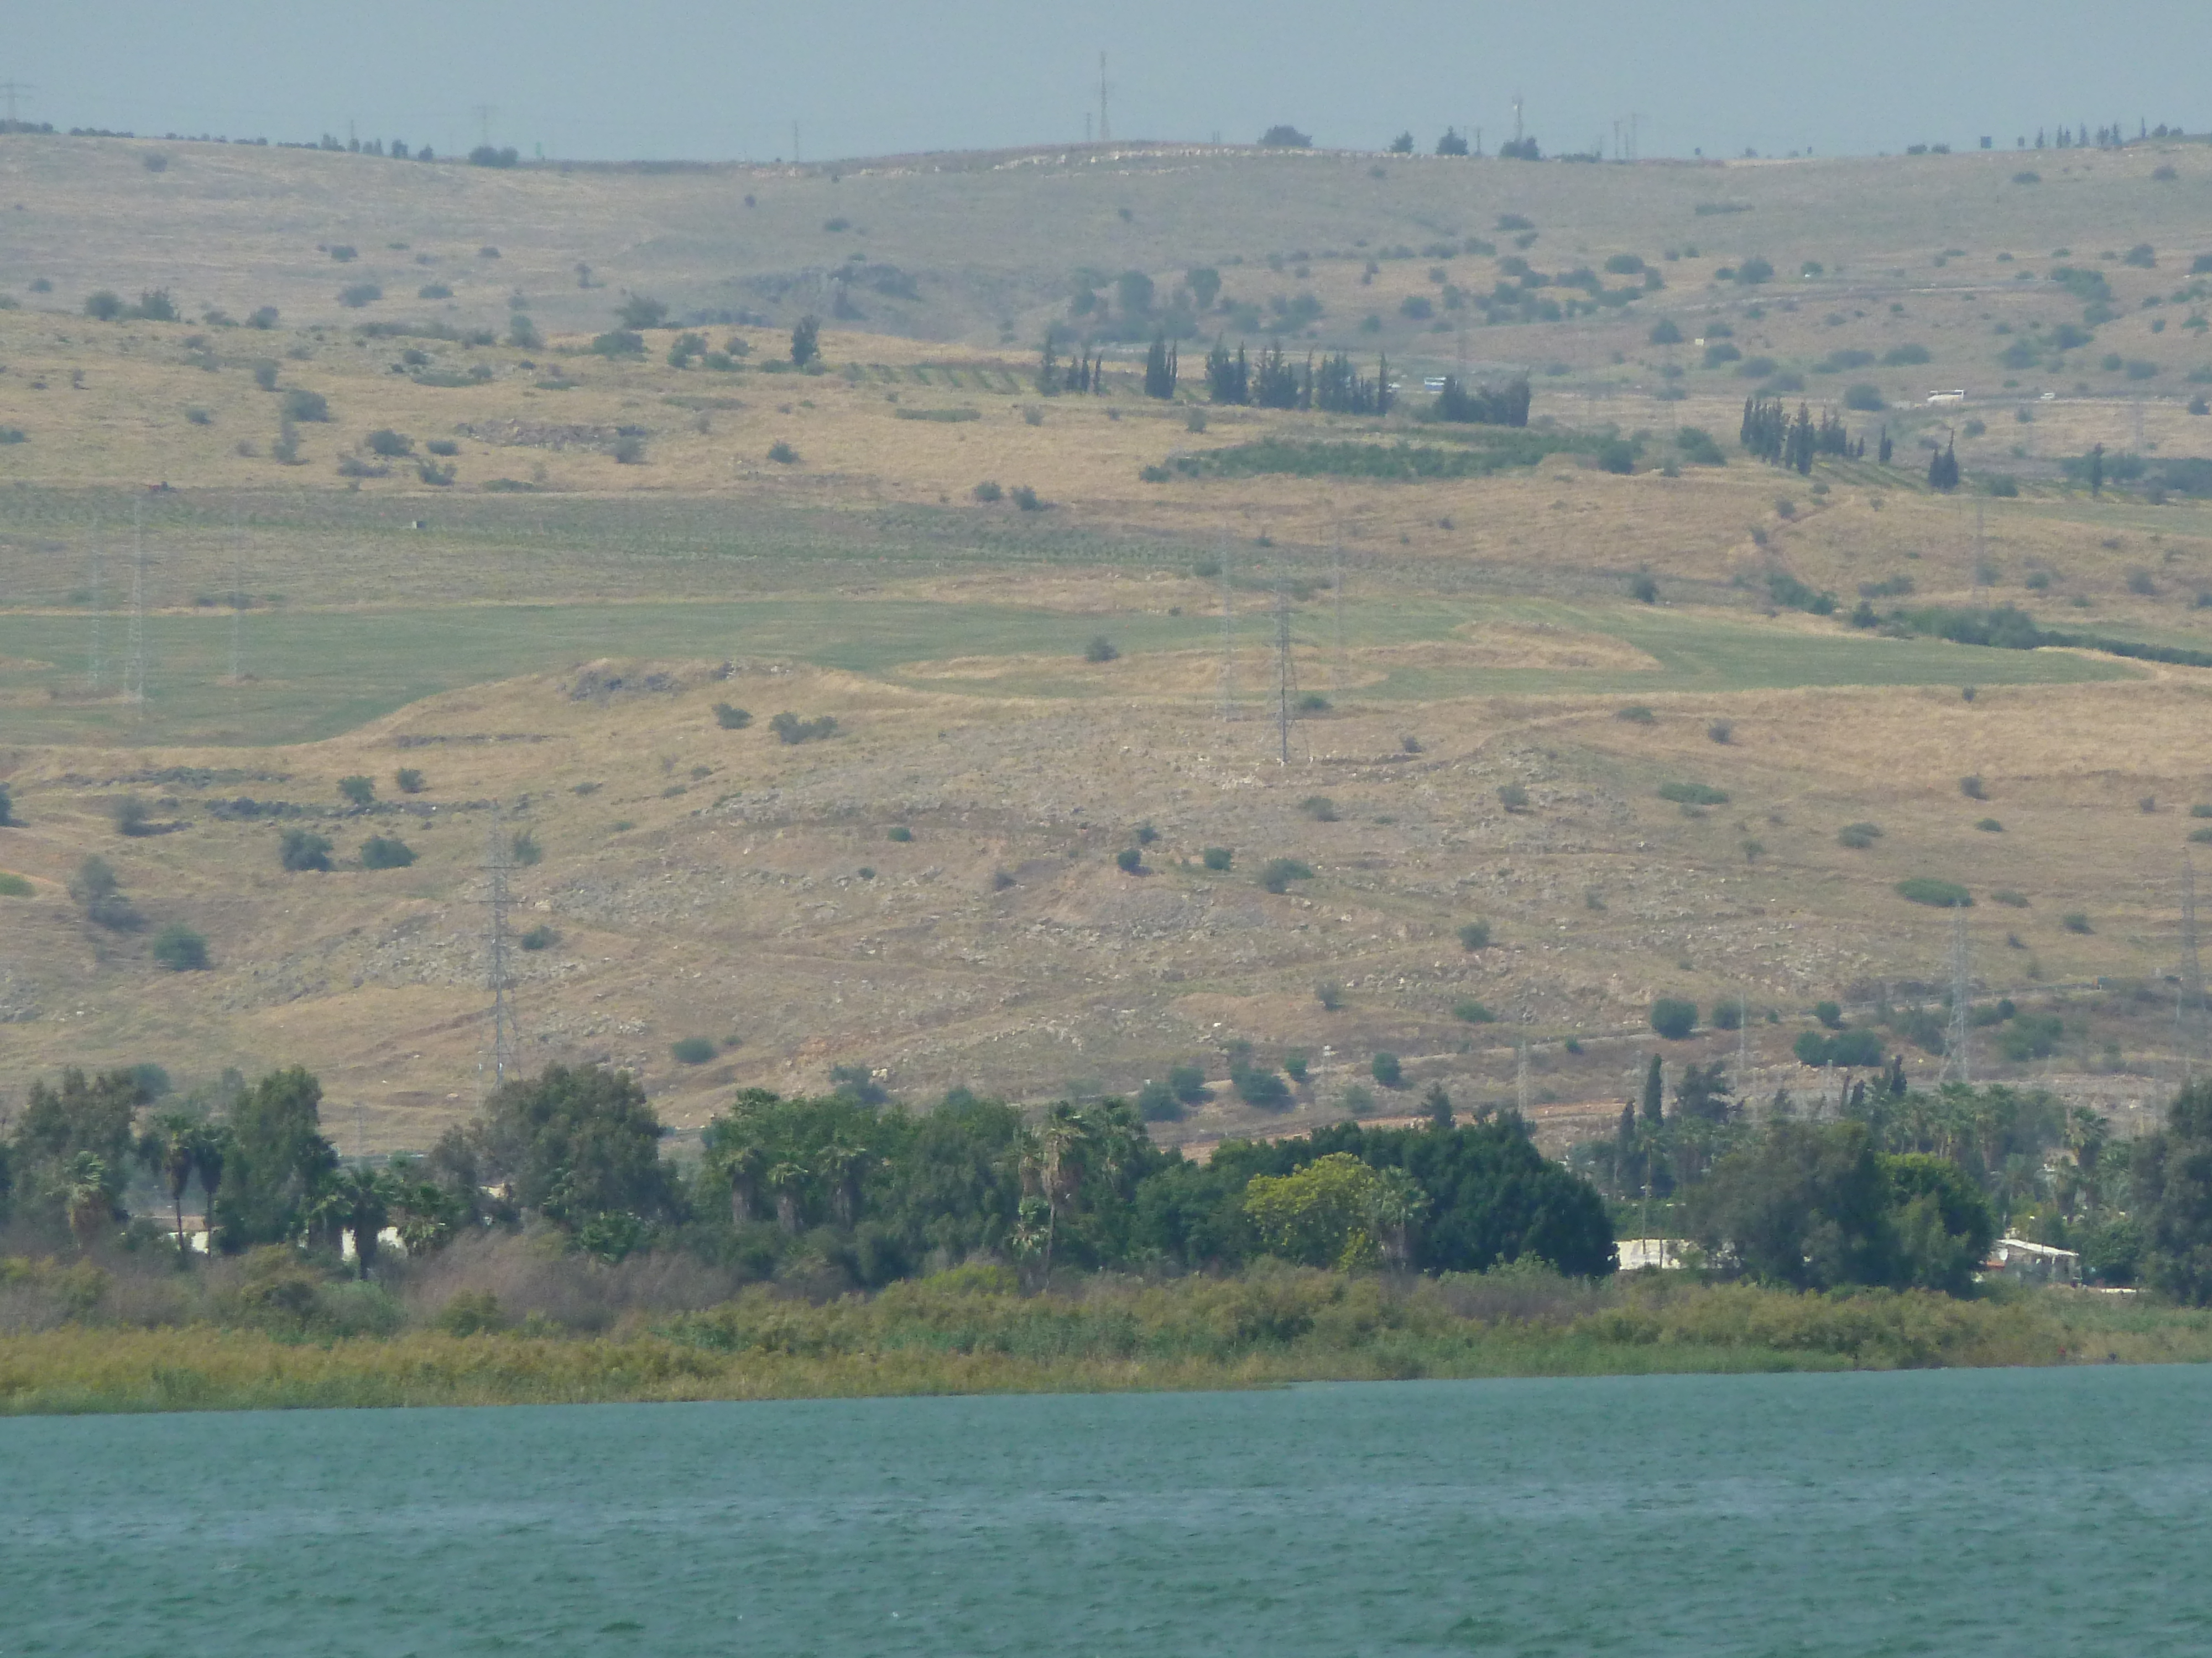
²⁰But he said to them, “It is I. Do not be afraid.” ²¹Then they wanted to take him into the boat, and immediately the boat came to the land where they had been heading.
ἐγώ εἰμι = I am

Slide 15
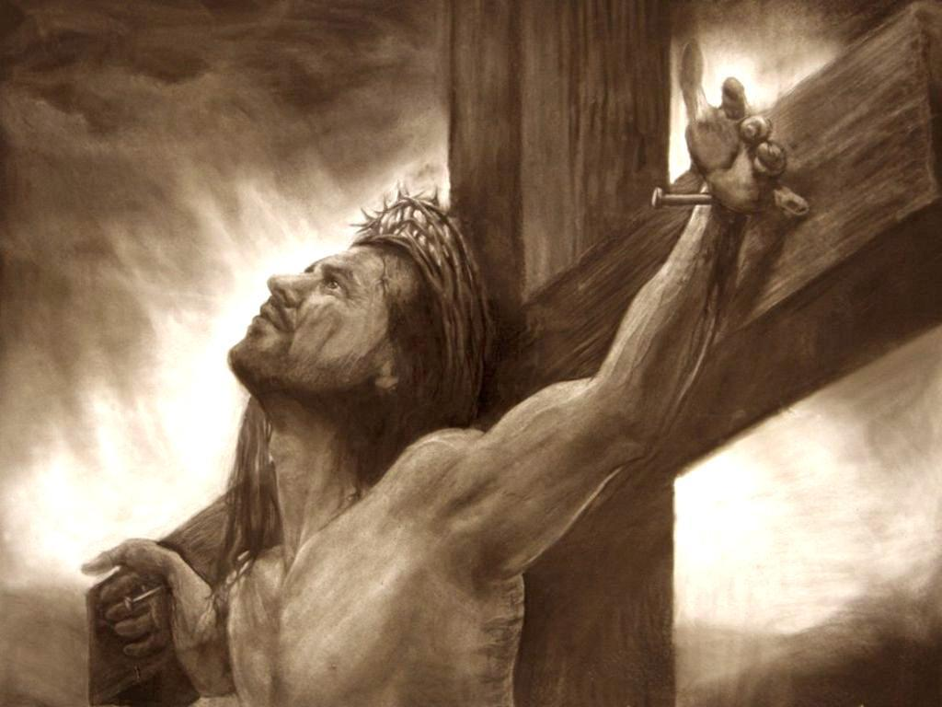
Image from hd4desktop.com

